Slide 1

ABH

Slide 2
Data Flow Diagram (Level-0 and Level-1) for an ATM system

Slide 3
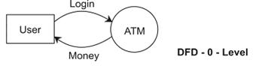

Slide 4
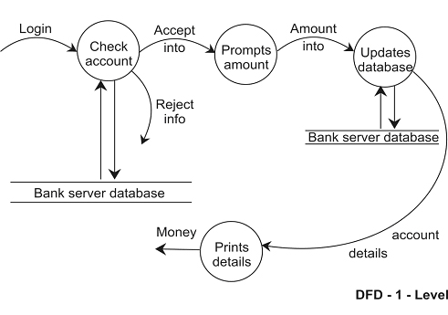

Slide 5
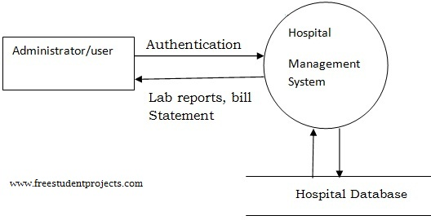
Hospital Management System
Level 0

Slide 6
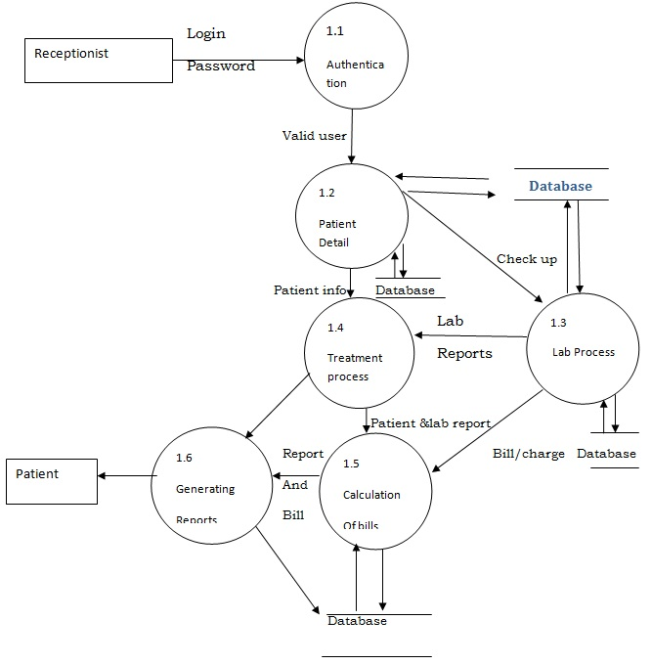
Level 1

Slide 7
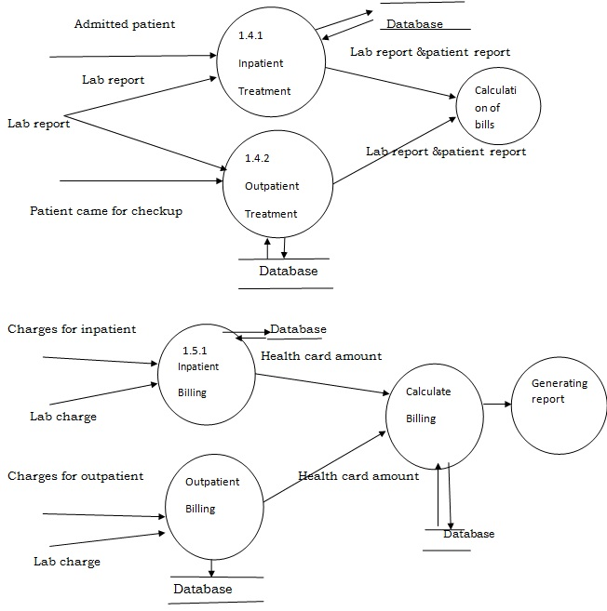
Level 2

Slide 8
Analysis
Description of Component
Administration module(1.1)-
Input: – User Name, Password
Process Definition: – Login to the system
Output:-If login is successful then administrator can view and update the records.
Inpatient module (1.2): -
Input: – Inpatient detail
Process Definition: – Information about the treatment given to the patients who are admitted.
Output: – Information about the patient.
Interface with other module: – The inpatient details are necessary for lab reports and billing.
Outpatient module(1.4) :-
Input: – Outpatient detail
Process Definition: – This module has the information about the treatment given to the patient who are came to check up.
Output: – Information about the patient.
Interface with other module: – The outpatient details are necessary for lab reports and billing.

Slide 9
Analysis
Lab module(1.3):-
Input: – Patient ID, Category
Process Definition:-Laboratory reports of the patient.
Output: – Lab report and charge.
Interface with other module: – This module requires information from inpatient and outpatient modules.
Billing module(1.5):-
Input: – Patient ID
Process Definition:-Calculates bill and deduct amount if any card facility is available.
Output: – Bill.
Interface with other module: – Billing module requires information from inpatient and outpatient modules.

Slide 10
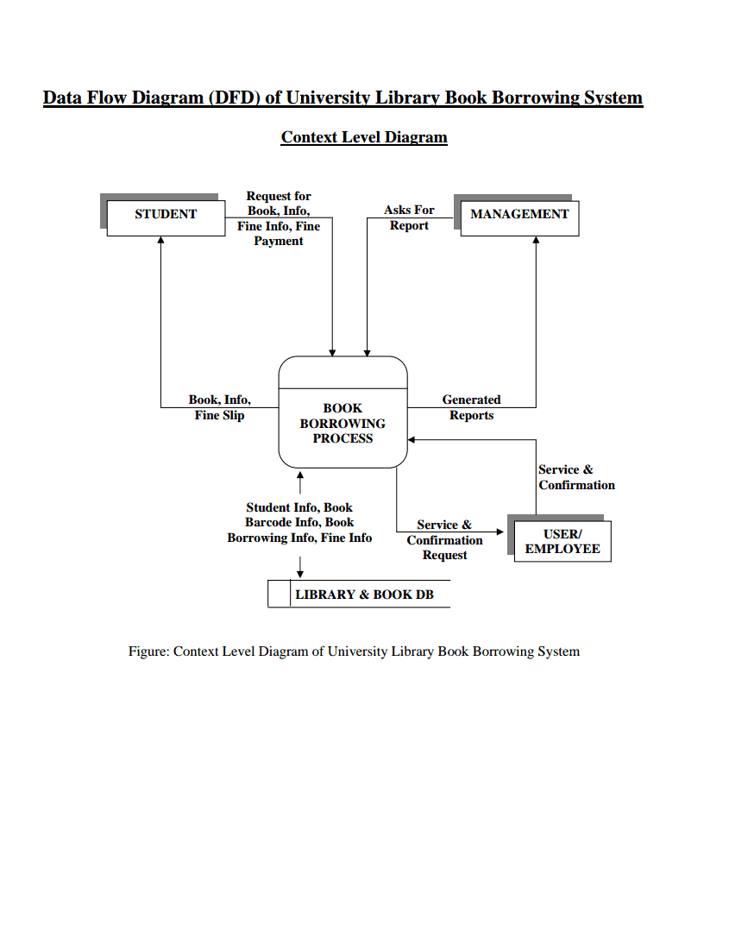
Library Management System(Level 0)

Slide 11
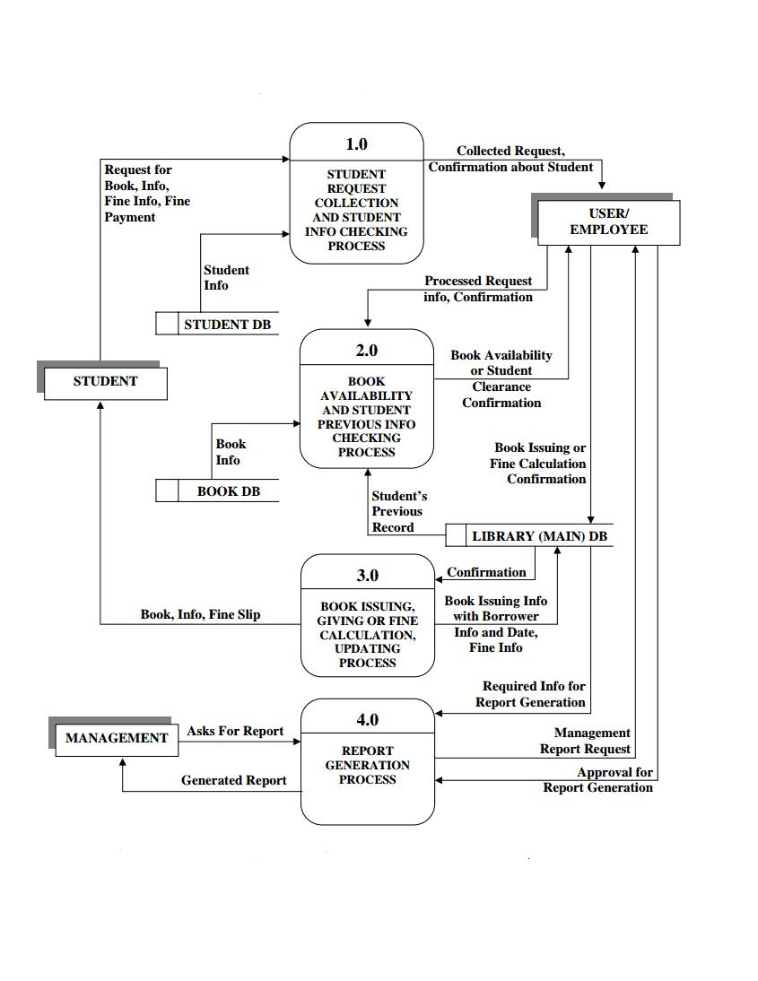
Level 1

Slide 12
THANK YOU

